Slide 1
PMG 4101: Project Management
Syed Samin Sadaf
Lecturer
Department of CSE,
United International University (UIU)

Slide 2

Hey there, stranger!

Slide 3
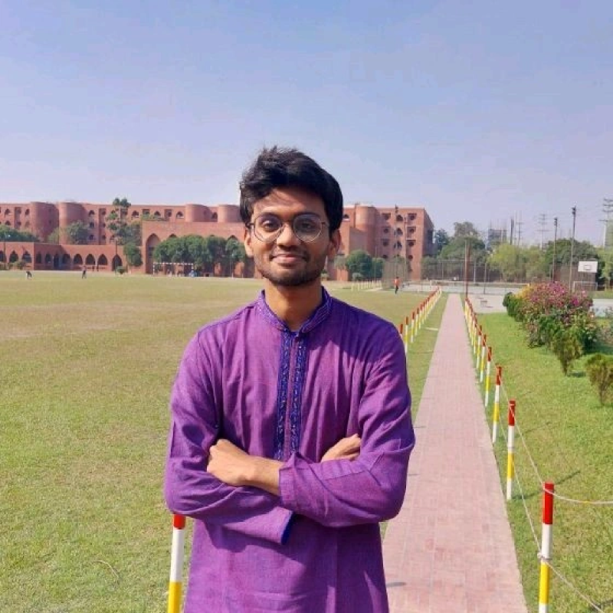
Brief Introduction
Syed Samin Sadaf
Lecturer, Dept. of CSE, UIU
BSc in Software Engineering,
Islamic University of Technology (IUT)
Office: 536 D

Slide 4
Contact
For any queries send an email to: sadaf@cse.uiu.ac.bd.
Counseling hour consultations are walk-in, but pre-appointments are appreciated.
E-mail
Phone
>>>

Slide 5


Slide 6
Brief Introduction (2)
Full Name
Where are you from?
School
College
Hobby
What do you know about this course?
How do you want this course to be conducted?
Do you want to cooperate with the class? If yes, how?

Slide 7
Nuances
Don’t get afraid
Don’t give up
If you follow my class closely, you will NOT need anything else for this course*.
*Conditions applied

Slide 8

Ground Rules
Pay attention and actually take notes, not pics.

Slide 9

Ground Rules
Be responsive in the classroom.

Slide 10
Ground Rules
Be present in class.
For absence due to valid reasons, send me an email at your earliest convenience with proper reasoning and documents (if applicable).

Slide 11
Ground Rules
The deadline for the assignments will NOT be extended under any circumstances.
NO makeup class tests will be allowed under any circumstances.
Copying questions in the answer script will NOT bring any marks.

Slide 12
Welcome to Project Management!

Slide 13
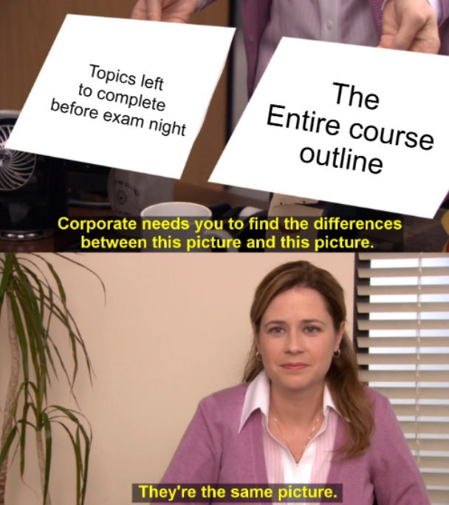
Course Outline
Shared Drive Folder

Slide 14
Course Outline
Week 1-2 | Project management, Different methodology of project management. Inception on Research work and group formation
Week 3-4 | Project Planning and schedule on SRS documents. Study and consider Risk planning
Week 5-6 | Estimation through WBS method, Delphi method
Week 7-8 | Estimation through COCOMO method Quality/process improvement CMMI, six sigma etc.
Week 9-10 | Change management methods, Review Techniques
Week 11-12 | Study on contemporary PM tools. Managing the Software project through modern PM tools Project Closing

Slide 15
Assessment Types | Marks
Attendance | 5%
Assignments | 5%
Class Tests | 20%
Reports | 5%+5%
Mid Term | 25%
Final Exam | 35%

Slide 16
Letter Grade | Marks % | Grade Point | Letter Grade | Marks% | Grade Point
A (Plain) | 90-100 | 4.00 | C+ (Plus) | 70-73 | 2.33
A- (Minus) | 86-89 | 3.67 | C (Plain) | 66-69 | 2.00
B+ (Plus) | 82-85 | 3.33 | C- (Minus) | 62-65 | 1.67
B (Plain) | 78-81 | 3.00 | D+ (Plus) | 58-61 | 1.33
B- (Minus) | 74-77 | 2.67 | D (Plain) | 55-57 | 1.00
 |  |  | F (Fail) | <55 | 0.00

Slide 17
1 | 2 | 3 | 4 | 5 | 6 | Mid | 7 | 8 | 9 | 10 | 11 | 12 | Final
# Class Test, n = 4
Tentative Schedule:
First CT: 3rd Week
Second CT: 6th Week
Third CT: 9th Week
Fourth CT: 11th Week
Time: 15-20 Minutes
Syllabus: At max 2 lectures
Best (n-1) will be counted for CT Marks.
NO MAKEUP CT WILL BE ALLOWED.

Slide 18
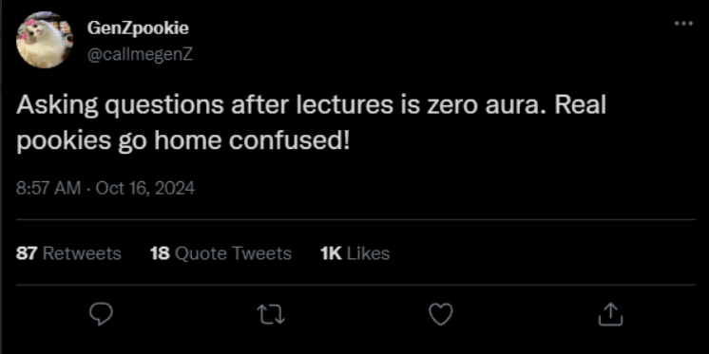

Slide 19
Any Questions?

Slide 20
Thank You!

